Slide 1

Introduction to RL – Part 1
TA. Bogyeong Suh
Machine Learning &
Control Systems Lab.

Slide 2
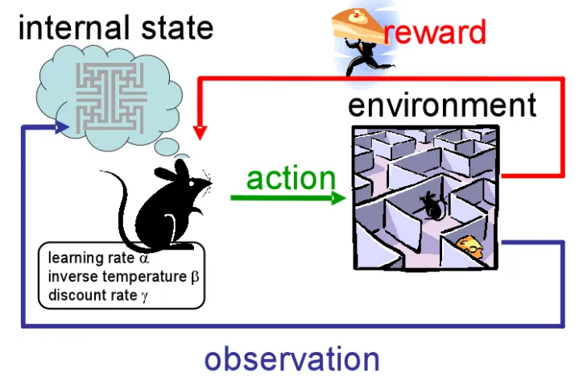
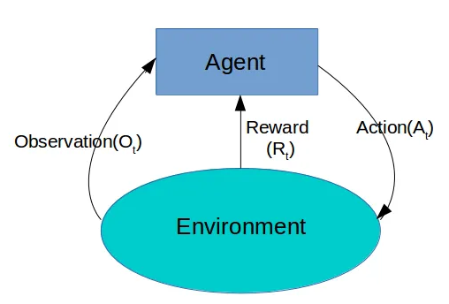
Definition
Reinforcement Learning
Goal-oriented Learning, where the primary objective is to train models to make sequences of decisions by discovering strategies that maximize a reward signal
Two primary entities in RL are agent and environment. Agent learns and make decisions, and environment is where the agent operates.
Agent interacts with the environment, takes an action based on a policy, receives a reward and observes the next state.
https://becominghuman.ai/the-very-basics-of-reinforcement-learning-154f28a79071

Slide 3
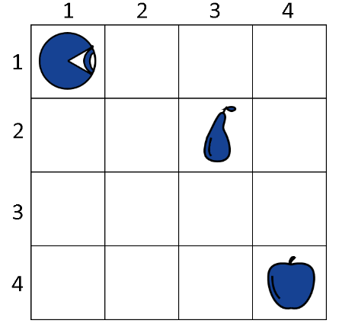
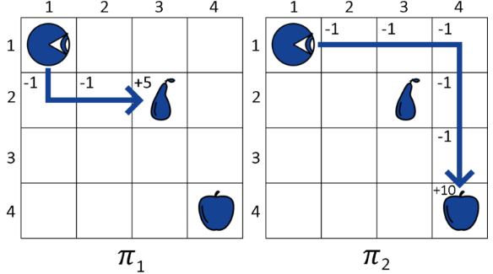
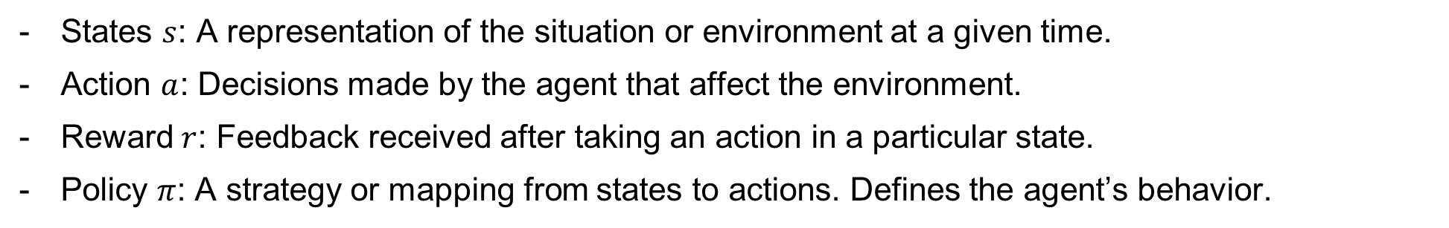
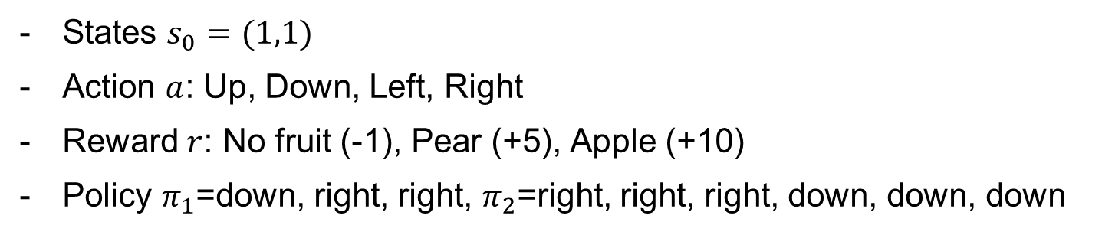
Key Concepts in Reinforcement Learning
Reinforcement Learning
States $s$: A representation of the situation or environment at a given time.
Action $a$: Decisions made by the agent that affect the environment.
Reward $r$: Feedback received after taking an action in a particular state.
Policy $π$: A strategy or mapping from states to actions. Defines the agent’s behavior.
https://www.baeldung.com/cs/ml-policy-reinforcement-learning
States $s_{0}=(1,1)$
Action $a$: Up, Down, Left, Right
Reward $r$: No fruit (-1), Pear (+5), Apple (+10)
Policy $π_{1}$=down, right, right, $π_{2}$=right, right, right, down, down, down

Slide 4
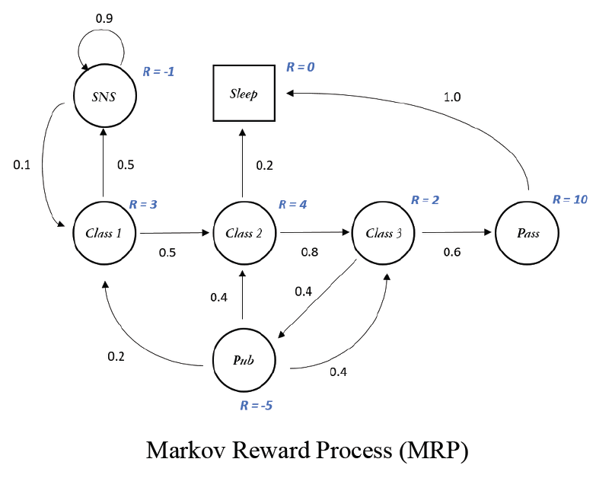
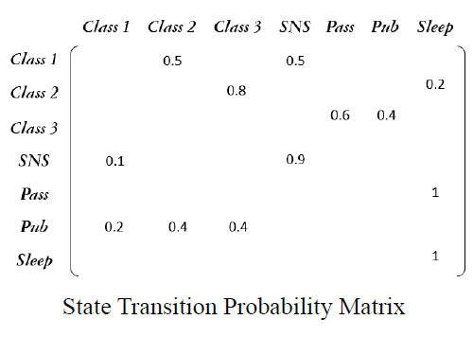
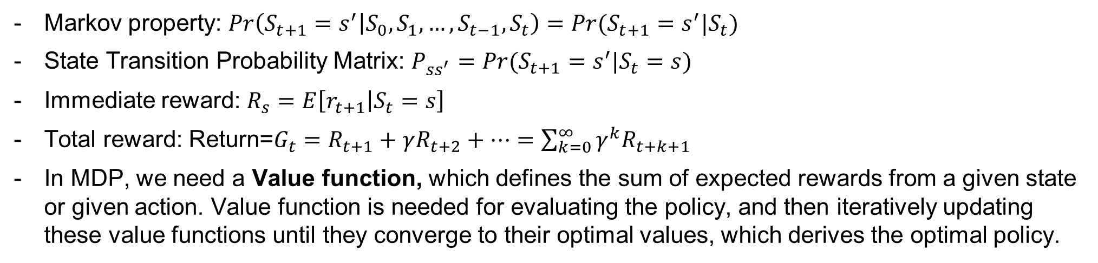
Key Concepts in Reinforcement Learning
Markov Decision Process
The process of RL is usually given as Markov Decision Processes (MDPs), which is a mathematical framework used for modeling decision making in situations where the outcomes are partly random and partly under the control of a decision maker.
https://untitledtblog.tistory.com/139
Markov property: $Pr\left(S_{t+1}=s^{′} | S_{0}, S_{1}, …, S_{t−1}, S_{t}\right)=Pr(S_{t+1}=s^{′}|S_{t})$
State Transition Probability Matrix: $P_{ss^{′}}=Pr⁡(S_{t+1}=s^{′}|S_{t}=s)$
Immediate reward: $R_{s}=E\left[r_{t+1} | S_{t}=s\right]$
Total reward: Return=$G_{t}=R_{t+1}+γR_{t+2}+…=\sum_{k=0}^{∞}{γ^{k}R_{t+k+1}}$
In MDP, we need a Value function, which defines the sum of expected rewards from a given state or given action. Value function is needed for evaluating the policy, and then iteratively updating these value functions until they converge to their optimal values, which derives the optimal policy.

Slide 5
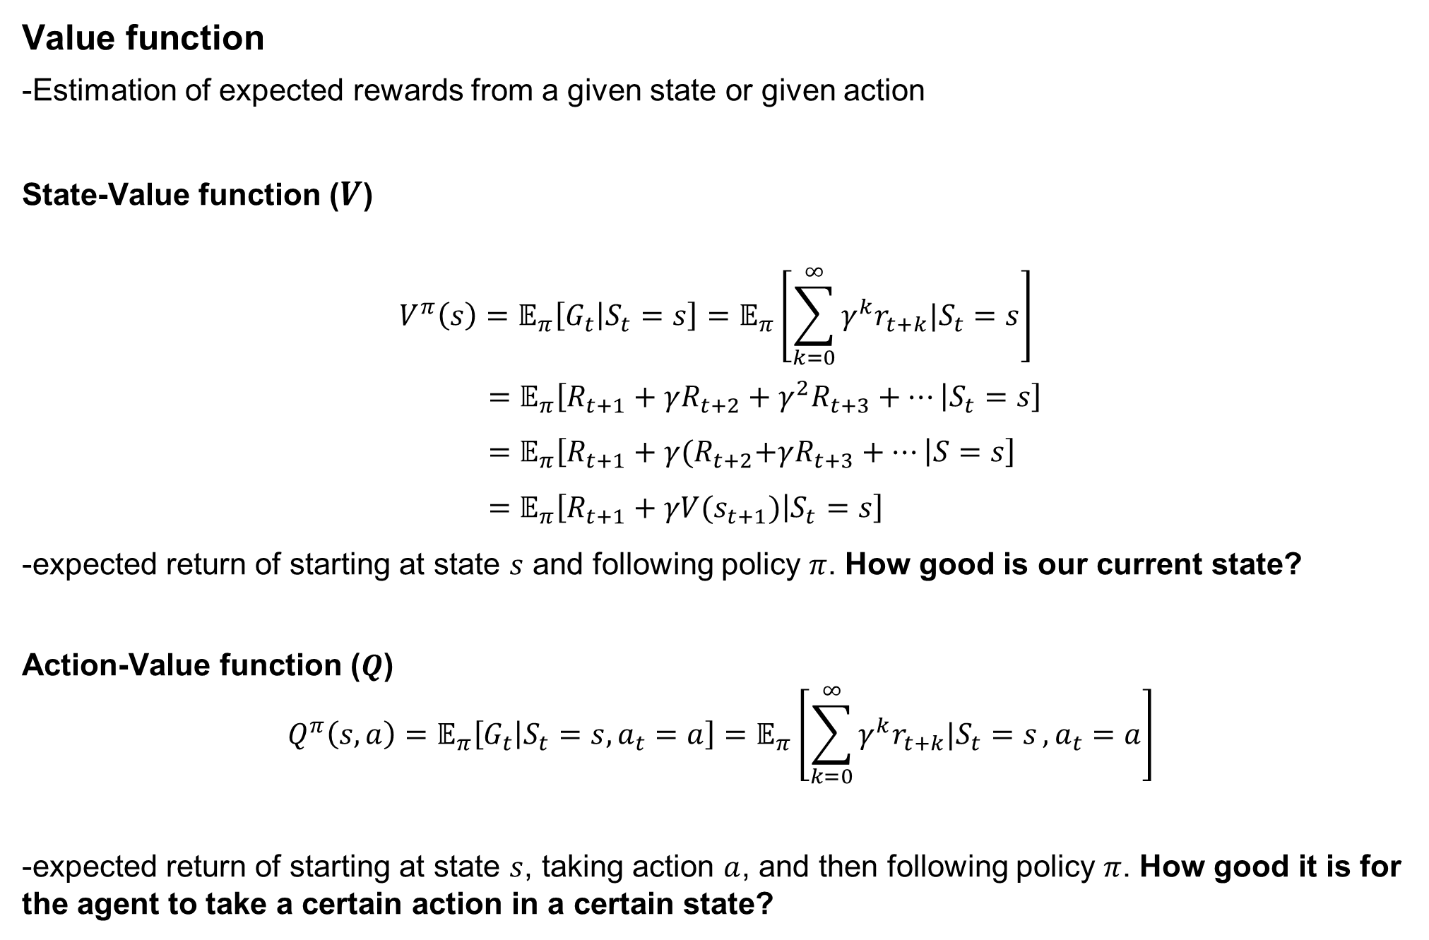

Key Concepts in Reinforcement Learning
Value function
-Estimation of expected rewards from a given state or given action
State-Value function ($V$)
$$V^{π}\left(s\right)=𝔼_{π}\left[G_{t} | S_{t}=s\right]=𝔼_{π}\left[\sum_{k=0}^{∞}{γ^{k}r_{t+k}|S_{t}=s}\right] \\ =𝔼_{π}\left[R_{t+1}+γR_{t+2}+γ^{2}R_{t+3}+… | S_{t}=s\right] \\ =𝔼_{π}\left[R_{t+1}+γ{(R}_{t+2}+γR_{t+3}+… | S=s\right] \\ =𝔼_{π}\left[R_{t+1}+γV(s_{t+1}) | S_{t}=s\right]$$
-expected return of starting at state $s$ and following policy $π$. How good is our current state?
Action-Value function ($Q$)
$$Q^{π}\left(s,a\right)=𝔼_{π}\left[G_{t} | S_{t}=s, a_{t}=a\right]=𝔼_{π}\left[\sum_{k=0}^{∞}{γ^{k}r_{t+k}|S_{t}=s}, a_{t}=a\right]$$
-expected return of starting at state $s$, taking action $a$, and then following policy $π$. How good it is for the agent to take a certain action in a certain state?
*$γ$=discount factor

Slide 6
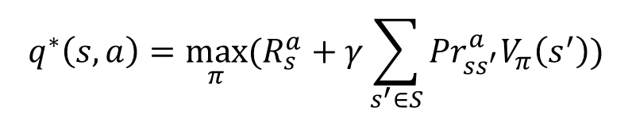
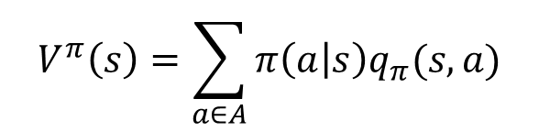
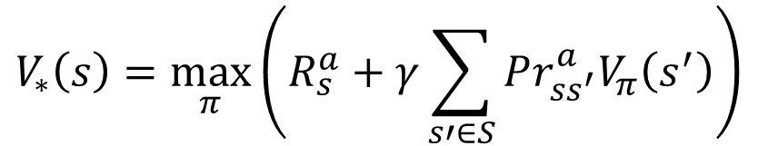
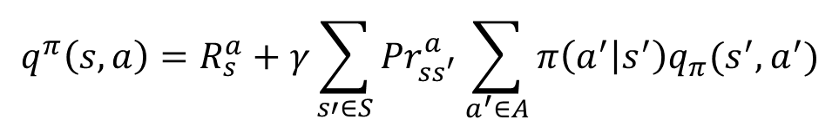

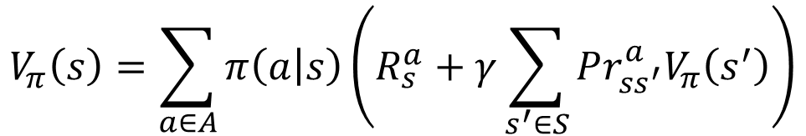
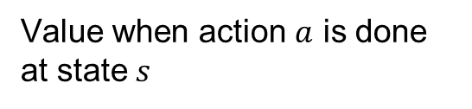
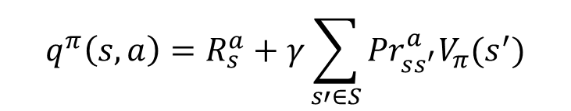
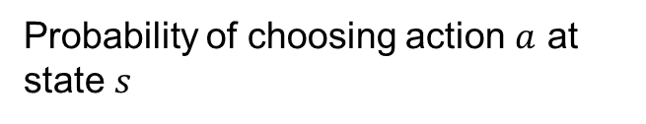
Key Concepts in Reinforcement Learning
State-value function with Action-value function
$$V^{π}\left(s\right)=\sum_{a∈A}{π\left(a | s\right)q_{π}(s,a)}$$
Value when action $a$ is done at state $s$
Probability of choosing action $a$ at state $s$
Action-value function with State-value function
$$q^{π}\left(s,a\right)=R_{s}^{a}+γ\sum_{s′∈S}{{Pr}_{ss^{′}}^{a}V_{π}(s^{′})}$$
Bellman Expectation equation
$$V_{π}\left(s\right)=𝔼_{π}\left[R+γV_{π}\left(s^{′}\right)\right]$$
$$V_{π}\left(s\right)=\sum_{a∈A}{π\left(a | s\right)\left(R_{s}^{a}+γ\sum_{s^{′}∈S}{Pr_{ss^{′}}^{a}V_{π}\left(s^{′}\right)}\right)}$$
$$q^{π}\left(s,a\right)=R_{s}^{a}+γ\sum_{s′∈S}{{Pr}_{ss^{′}}^{a}\sum_{a^{′}∈A}{π\left(a^{′} | s^{′}\right)q_{π}(s^{′},a^{′})}}$$
→We use Bellman Expectation equation for evaluating a certain policy
Bellman Optimality equation
$$V_{∗}\left(s\right)=\max_{π}{𝔼_{π}\left[R+γV_{∗}\left(s^{′}\right)|s_{t}=s, a_{t}=a\right] }$$
$$V_{∗}\left(s\right)=\max_{π}\left(R_{s}^{a}+γ\sum_{s′∈S}{Pr_{ss^{′}}^{a}V_{π}\left(s^{′}\right)}\right)$$
$$q^{∗}\left(s,a\right)=\max_{π}⁡(R_{s}^{a}+γ\sum_{s^{′}∈S}{{Pr}_{ss^{′}}^{a}V_{π}\left(s^{′}\right)})$$
→We use Bellman Optimality equation for choosing the optimal policy $π^{∗}$ which produces the maximum value

Slide 7
Key Concepts in Reinforcement Learning
Algorithms for solving MDP
Dynamic Programming (DP)
Refers to a collection of algorithms that can be used to compute optimal policies given a perfect model of the environment as a MDP
It predicts the value function of current policy (prediction) and optimize the policy (control)
Policy Iteration
Iterative process of policy evaluation and policy improvement to find the optimal policy
Uses Bellman expectation equation
Value Iteration
Simplification of policy iteration that combines the policy evaluation and policy improvement steps.
The policy at each state is updated by choosing the action that leads to the maximum sum.
Uses Bellman optimality equation

Slide 8
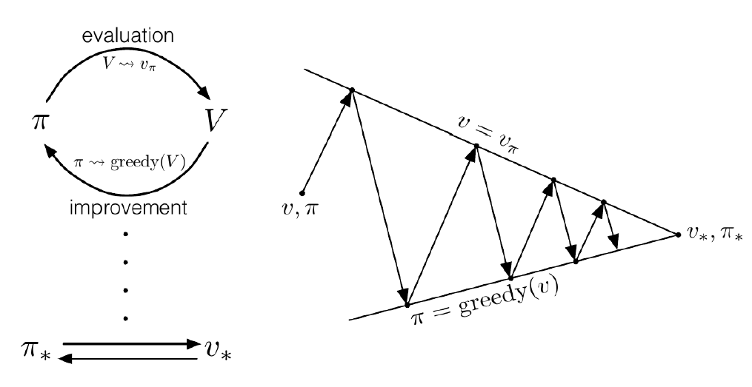
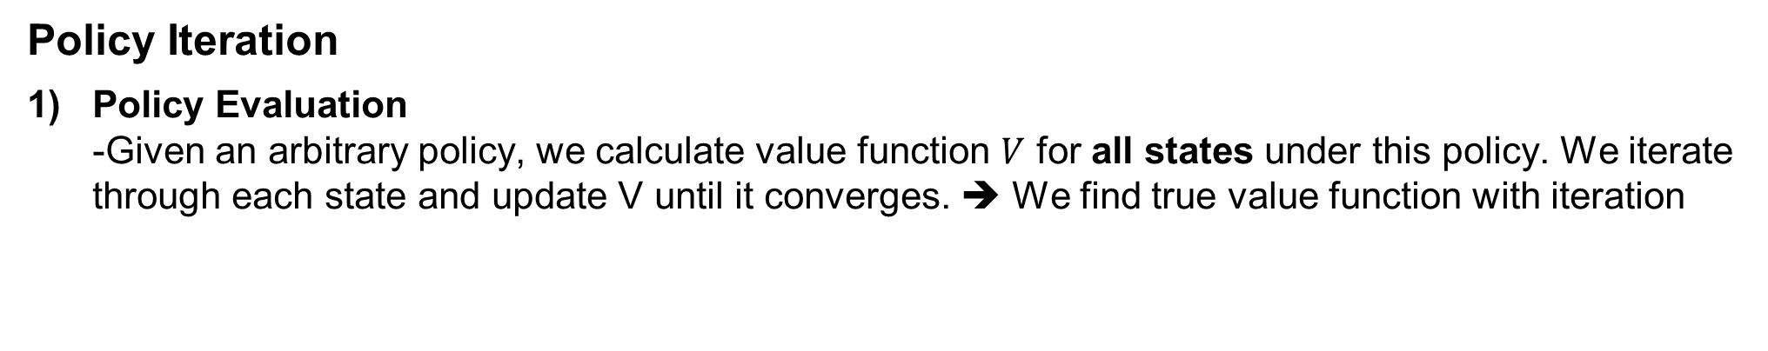
Key Concepts in Reinforcement Learning
Policy Iteration
Policy Evaluation -Given an arbitrary policy, we calculate value function $V$ for all states under this policy. We iterate through each state and update V until it converges. ➔ We find true value function with iteration

Slide 9
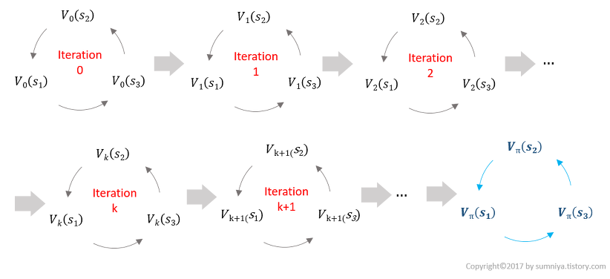

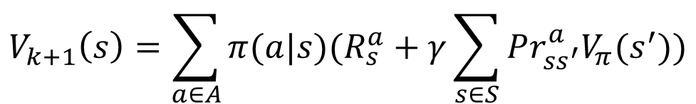
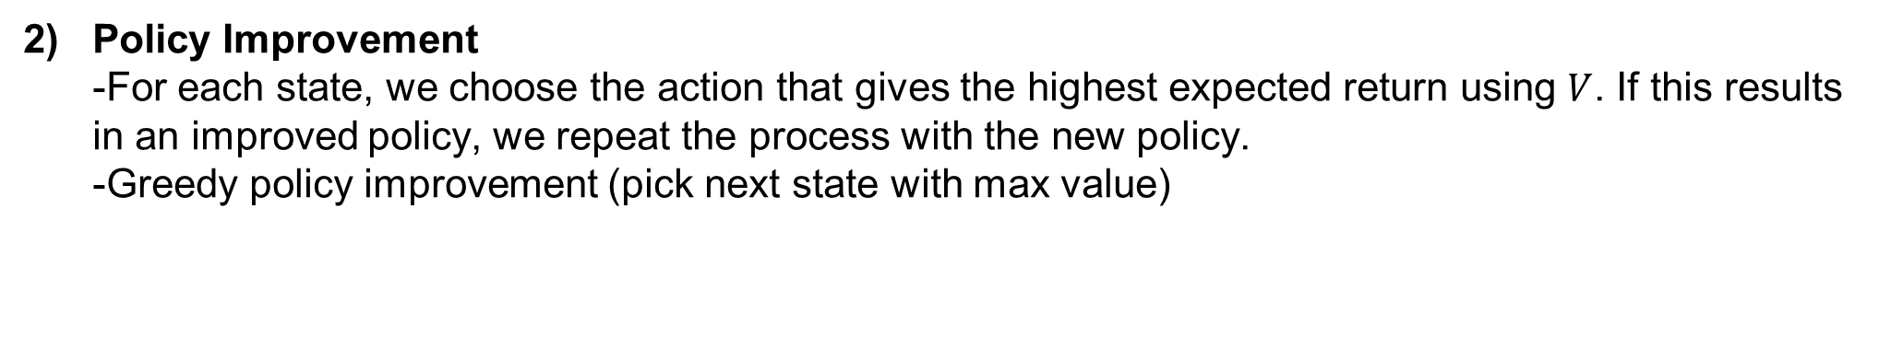
Key Concepts in Reinforcement Learning
Policy Iteration
Policy Evaluation -Given an arbitrary policy, we calculate value function $V$ for all states under this policy. We iterate through each state and update V until it converges. ➔ We find true value function with iteration
$$V_{k+1}\left(s\right)=\sum_{a∈A}{π(a|s)(R_{s}^{a}+γ\sum_{s∈S}{Pr_{ss^{′}}^{a}V_{π}(s^{′})})}$$
Policy Improvement -For each state, we choose the action that gives the highest expected return using $V$. If this results in an improved policy, we repeat the process with the new policy. -Greedy policy improvement (pick next state with max value)
We repeat the process of Evaluation → Improvement → Evaluation ….

Slide 10
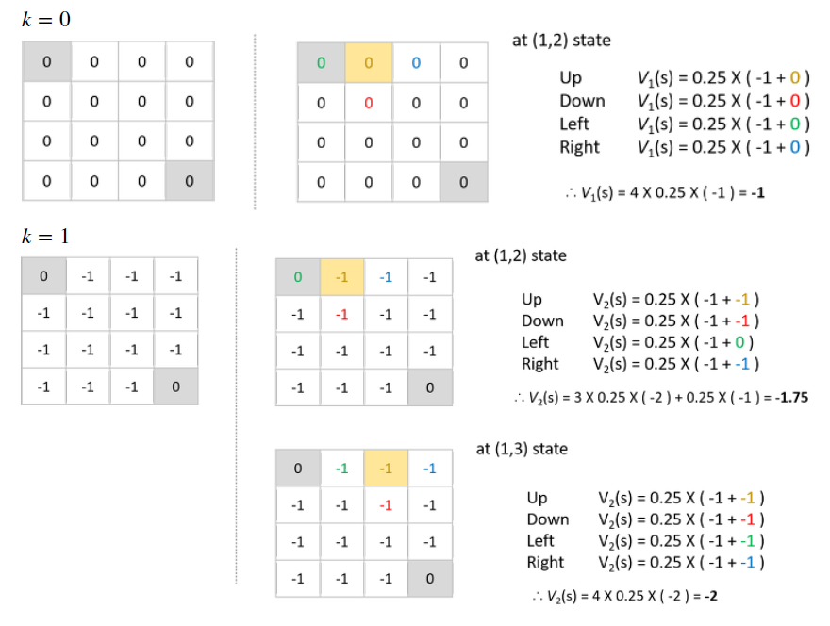
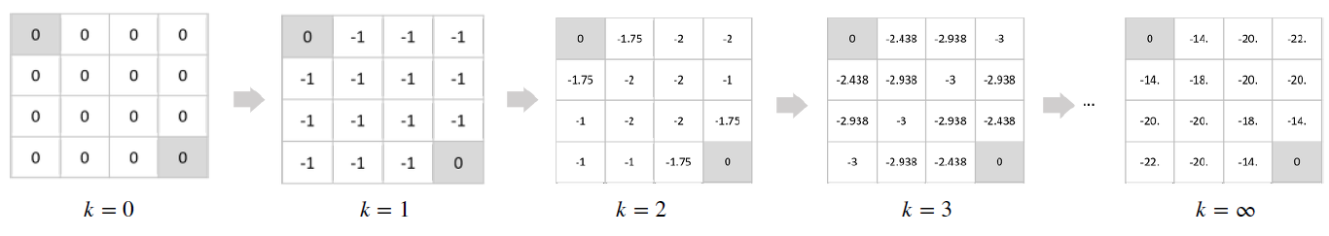
Key Concepts in Reinforcement Learning
Policy Iteration
Policy Evaluation

Slide 11
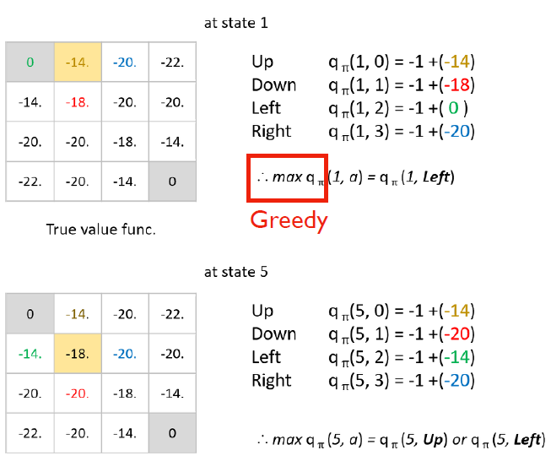
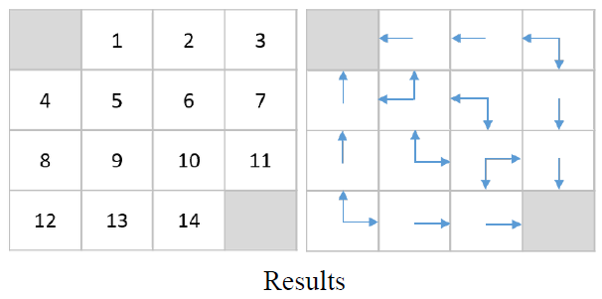
Key Concepts in Reinforcement Learning
Policy Iteration
Policy Improvement

Slide 12
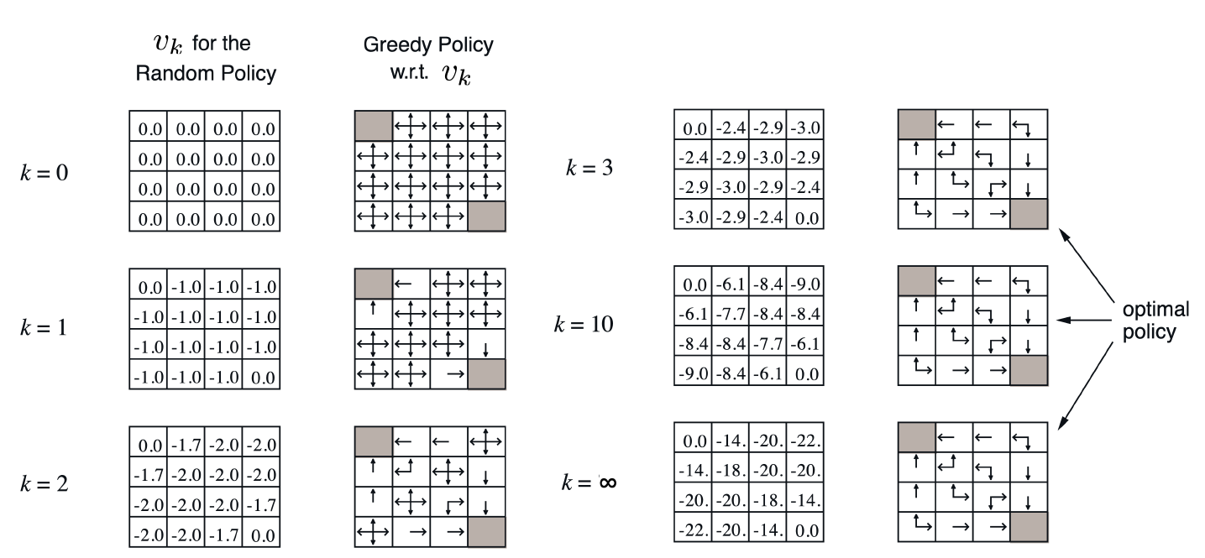
Key Concepts in Reinforcement Learning
Policy Iteration

Slide 13
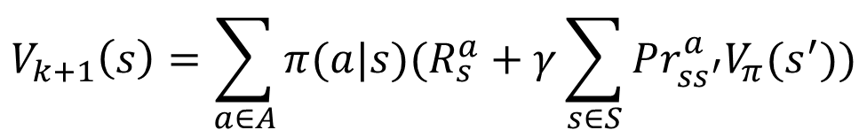
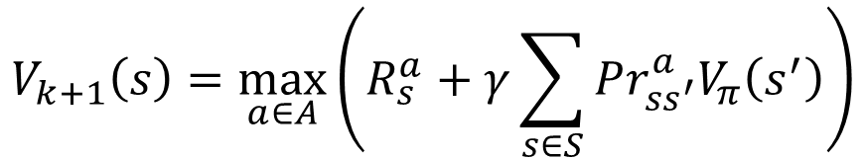
Key Concepts in Reinforcement Learning
Value Iteration
Instead of summing all possible states’ value functions, we only take the max value.
Thus, policy improvement is included in the iteration itself, because we choose the action with maximum value function.
Policy evaluation in value iteration (which finds the true value function) implies the improvement to optimal policy.
$$V_{k+1}\left(s\right)=\sum_{a∈A}{π(a|s)(R_{s}^{a}+γ\sum_{s∈S}{Pr_{ss^{′}}^{a}V_{π}(s^{′})})}$$
$$V_{k+1}\left(s\right)=\max_{a∈A}\left(R_{s}^{a}+γ\sum_{s∈S}{Pr_{ss^{′}}^{a}V_{π}\left(s^{′}\right)}\right)$$
Policy Iteration
Value Iteration

Slide 14
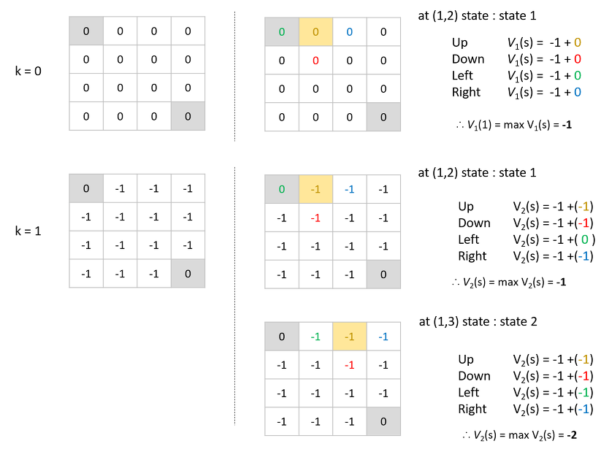
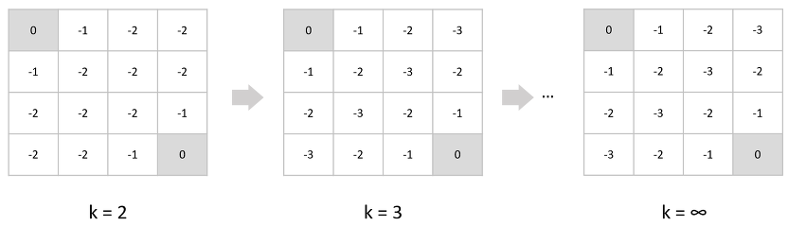
Key Concepts in Reinforcement Learning
Value Iteration

Slide 15
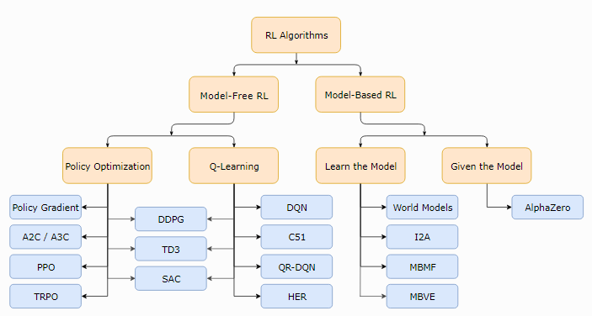
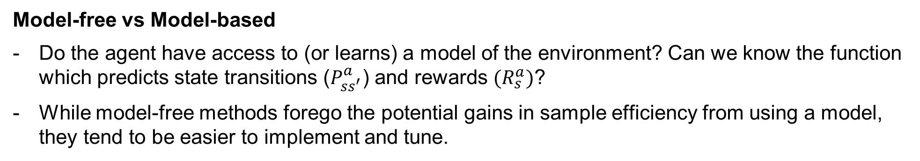
Types of Reinforcement Learning
Taxonomy of RL algorithms
Model-free vs Model-based
Do the agent have access to (or learns) a model of the environment? Can we know the function which predicts state transitions ($P_{ss^{′}}^{a}$) and rewards $(R_{s}^{a})$?
While model-free methods forego the potential gains in sample efficiency from using a model, they tend to be easier to implement and tune.

Slide 16
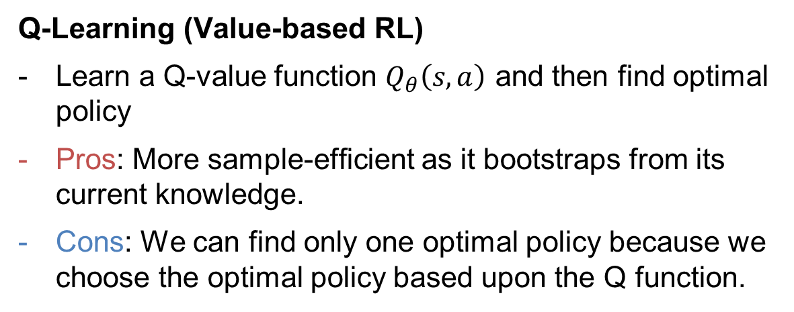
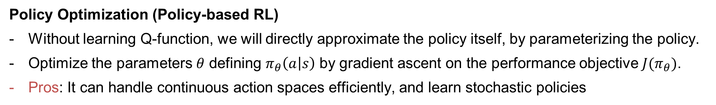
Types of Reinforcement Learning
Taxonomy of RL algorithms
Q-Learning (Value-based RL)
Learn a Q-value function $Q_{θ}\left(s,a\right)$ and then find optimal policy
Pros: More sample-efficient as it bootstraps from its current knowledge.
Cons: We can find only one optimal policy because we choose the optimal policy based upon the Q function.
Policy Optimization (Policy-based RL)
Without learning Q-function, we will directly approximate the policy itself, by parameterizing the policy.
Optimize the parameters $θ$ defining $π_{θ}\left(a | s\right)$ by gradient ascent on the performance objective $J(π_{θ})$.
Pros: It can handle continuous action spaces efficiently, and learn stochastic policies
Cons: May converge slowly as it has to explore the environment thoroughly to estimate the policy gradient accurately
Interpolating between Policy Optimization and Q-learning
There are trade-off between the strengths and weaknesses of either methods.
e.g) SAC: maintain both a policy (the actor) and a value function (the critic), using the value function to critique the policy’s action and adjust the policy parameters accordingly.

Slide 17
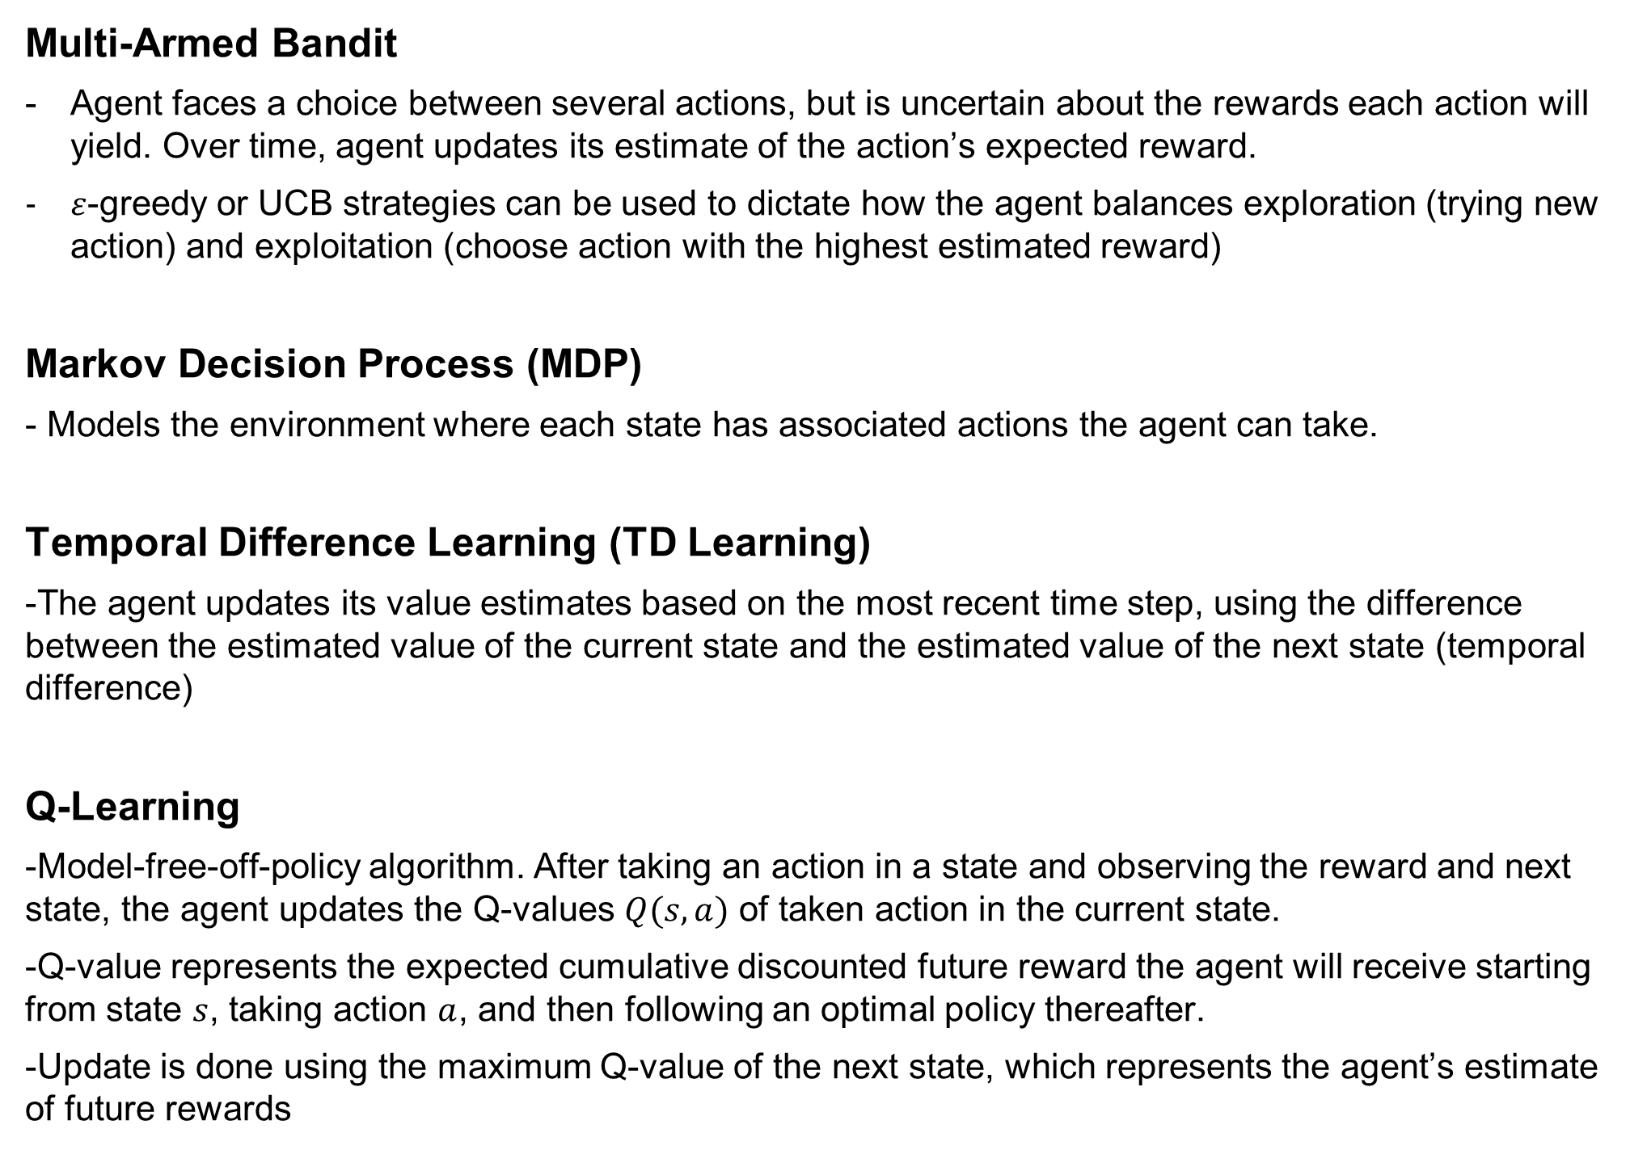
Appendix - Types of Reinforcement Learning
Multi-Armed Bandit
Agent faces a choice between several actions, but is uncertain about the rewards each action will yield. Over time, agent updates its estimate of the action’s expected reward.
$ε$-greedy or UCB strategies can be used to dictate how the agent balances exploration (trying new action) and exploitation (choose action with the highest estimated reward)
Markov Decision Process (MDP)
- Models the environment where each state has associated actions the agent can take.
Temporal Difference Learning (TD Learning)
-The agent updates its value estimates based on the most recent time step, using the difference between the estimated value of the current state and the estimated value of the next state (temporal difference)
Q-Learning
-Model-free-off-policy algorithm. After taking an action in a state and observing the reward and next state, the agent updates the Q-values $Q(s,a)$ of taken action in the current state.
-Q-value represents the expected cumulative discounted future reward the agent will receive starting from state $s$, taking action $a$, and then following an optimal policy thereafter.
-Update is done using the maximum Q-value of the next state, which represents the agent’s estimate of future rewards

Slide 18
Appendix - Types of Reinforcement Learning
State-Action-Reward-State-Action (SARSA)
-Instead of using maximum Q-value of the next state as in Q-learning, it uses the Q-value of the action that’s actually taken next.
Deep Reinforcement Learning (Deep RL)
-Combines neural networks with RL. A neural network approximates the value function or Q-function, and the parameters of the neural network are updated to minimize the difference between the predicted and target values or Q-values.
Inverse Reinforcement Learning (Inverse RL)
-Instead of learning a policy from given rewards, it seeks to understand the reward function by observing an expert’s behavior. Once the reward function is estimated, the agent can then use standard RL techniques to determine the optimal policy.

